Slide 1
working for everyone
Working with Trade Unions
Gareth Howard
Collective Conciliator

Slide 2

Agenda
Trade Unions & Current UK Developments
History of Trade Unions in the UK
The Employer rights bill
Practical implications for employers
Key terminology/processes
Where things can go wrong

Slide 3
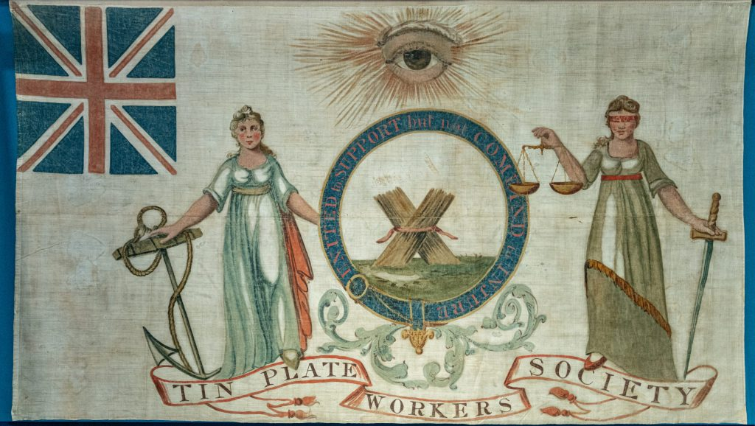
A Brief Historical Overview of UK Trade Unionism
Origins and Legalisation
Trade unions began in the 19th century challenging poor working conditions, gaining legal status in 1871
Tolpuddle Martyrs
20th Century Influence
Unions grew powerful in collective bargaining across major industries, shaping national employment standards
Legislative Challenges
1980s reforms restricted union powers, reducing influence over striking and picketing activities
Recent Reforms and Revival
2020s reforms like Employment Rights Act strengthen unions and enhance worker protections

Slide 4
What is a trade union?
A UK trade union is an independent, member-based organisation of workers—often in specific industries—formed to protect and improve working conditions, pay, and benefits through collective bargaining. They represent members in disputes, negotiate with employers, and provide legal or financial advice
"Recognised" unions have formal rights to negotiate on behalf of staff.
The legal framework for trade unions is primarily set out in the Trade Union and Labour Relations (Consolidation) Act 1992-Known as TULRCA

Slide 5
Who is in a trade union?
Who is Joining?
Gender: Female employees saw a rise in membership, making up 3.7 million members, while male membership fell in 2024.
Education: Roughly 62% of union members hold a degree or higher education qualification.
Longevity: Around 45% of members have been with their current employer for over 10 years.
Regions: Membership density increased in Scotland, Wales, and Northern Ireland in 2023.
Top Unions by Membership: UNISON (public services), Unite (general), GMB (general), NEU (education), and USDAW (retail/distribution)

Slide 6
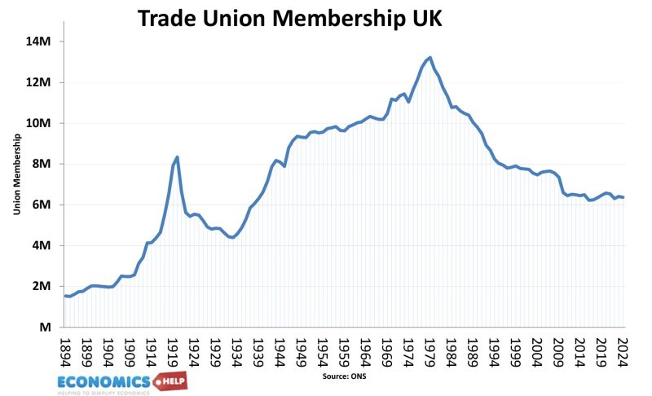
Membership density

Slide 7

Role of Trade Unions
Collective Strength and Negotiation
Trade unions empower workers to negotiate collectively for fair pay, security, and working conditions, enhancing employee influence.
Representation and Legal Support
Unions provide representation in disputes and disciplinary processes, ensuring fairness and specialist legal advice for employees.
Collective Bargaining and Industrial Stability
Unions negotiate sector-wide agreements with employers that stabilize pay and working conditions, improving employment standards.
Advocacy and Policy Reform
Trade unions advocate for legislative reforms to strengthen worker protections and promote fair labour laws and policies.

Slide 8

Collective Bargaining-what is covered
The parties roles
Prepare proposals
Formal negotiations
Understanding legal obligations around sharing information-Acas code of practice can help with this
Ensure managerial consistency
Agreement or stalemate
Acas involvement?

Slide 9
What is negotiating?
Negotiating is the process of holding formal or informal discussions with one or more parties to reach a mutually acceptable agreement, resolve disputes, or arrange terms, particularly in business or legal contexts.
It involves bargaining, exchanging ideas, and making compromises
Consider your approach-Do you have a strategy?
Full and final…

Slide 10
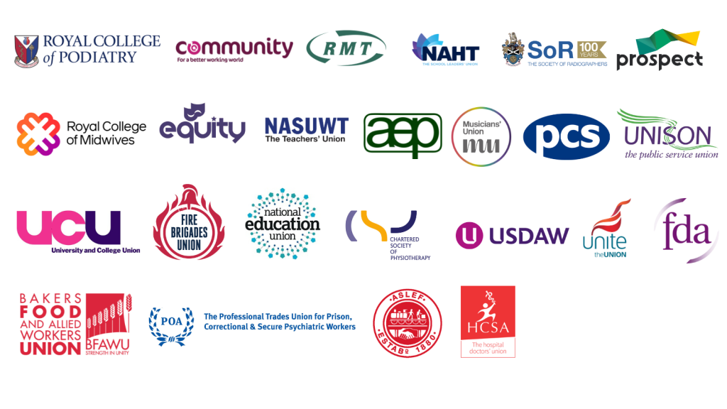
Understanding the trade unions

Slide 11
Friend or foe?
This really depends on your view of conflict and your own/the organisations philosophical perspective
A critical friend?
Transactional relationship
Acas research, 77% agree that working in partnership can benefit the organisation
Single point of contact
Keep the workforce well informed
Early identification of issues
Defined dispute resolution process
Access to knowledge beyond your organisation
Like any relationship, it can be strained-this is where HR can be better

Slide 12
Trade unions v other types of workplace forums
Workplace forums
Focus on consultation and joint decision-making on operational matters such as health and safety, job grading, and restructuring. They do not engage in wage negotiations
Limited to the specific company, with no, or very limited, statutory power to enforce decisions.
Trade Unions
Independent, often national or international organisations that represent members across different employers.
Possess legal rights, can initiate industrial action (strikes), and are supported by outside resources.

Slide 13
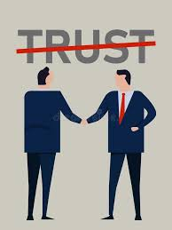
When it goes wrong
Late engagement
Working relationships
A lack of trust and/or confidence in handling collective issues-this is what I see most

Slide 14

What is trade union recognition?
Voluntary, statutory or ‘accidental’
The bargaining unit
What can be included?
Is it legally binding?
Dispute resolution procedure
Kostal v Dunkley
What if one party doesn’t follow the agreement?

Slide 15
Recognition
Trade Union recognition
Various changes intended to simplify the trade union recognition process are due to come into force in April 2026 with many, including new electronic balloting processes and preventing unfair practices during voting, currently subject to consultation. For example, a union will no longer be required to demonstrate to the Central Arbitration Committee (CAC) that there is a ‘likelihood’ of majority support for recognition in the bargaining unit.
Further, the requirement for 40% of the bargaining unit to vote in favour of recognition will be removed (meaning that a ‘simple majority’ of those actually voting will be sufficient).

Slide 16
Current legal reforms and their impact-February and April 2026 changes
Simplified Ballot Requirements
The Act removes the 50% turnout threshold, requiring only a simple majority for strike ballots to authorise action.
Reduced Notice Period
Notice period for industrial action is shortened from 14 to 10 days, accelerating mobilisation and reducing preparation time for employers.
Repeal of Restrictions: Repeal of the Strikes (Minimum Service Levels) Act 2023 and most of the Trade Union Act 2016.
Extended Mandate Validity
Industrial action mandates now last 12 months instead of 6, allowing longer sustained pressure without repeat ballots.
Modernised Voting Methods
Electronic balloting is introduced alongside postal voting, modernising the process and potentially increasing voter turnout.
Protection for employees for taking industrial action
Previously, employees taking part in industrial action were only protected from unfair dismissal for an initial ‘protected period’ of 12 weeks. This has now been removed and protection is open-ended

Slide 17

Derecognition
Shines a light on the situation
Damage industrial relations
Reputational damage
Perception of something lost
Loss of employee voice
But we have an employee forum!

Slide 18

Managing the relationship in practice
Ignoring contact
PUTBP
Not treating each other as equals-lack of respect-they don’t speak for everyone…
Conflict? That’s bad! Are you a unitarist?
Language used-yours and theirs-’shopping lists’
Preconceived ideas
Ignoring feelings or concerns
Lack of interest
Rushing
Mehrabian (2017) the importance of body language

