Slide 1
The Good Practice Power Hour:
Health and Wellbeing
People Management
Thursday 14 December 2023
Speakers
Alexia Rhodes Good Employment Charter
Nicola Ryan One+All
Donald Moore One+All
Jo Bohan Wigan & Leigh College
Louise Brown Wigan & Leigh College
Supported by

Slide 2
Welcome
Introduction and housekeeping
Health & Wellbeing – Nicola Ryan, (Director of Colleague Support) & Donald Moore (Chair), One+All
People Management– Jo Bohan (Head of HR) & Louise Brown (Vice Principal), Wigan & Leigh College
Q & A
End
#GoodPracticePowerHour

Slide 3
Housekeeping
This webinar is recorded
Chat function to connect with attendees
Q&A function specifically for questions
Please keep microphones muted unless asking a question
Reaction button
#GoodPracticePowerHour

Slide 4
Health & Wellbeing
Nicola Ryan & Donald Moore
Director of Colleague Support and Chair
One+All

Slide 5
9 steps to Financial Wellbeing
December 2023

Slide 6
STEP ONE - PAY & SECURE WORK
Pay the Real Living Wage and comply with living hours
Too many workers on low pay and insecure work - zero hours, etc.
1 in 4 children in GM in poverty - half with working parents

Slide 7
STEP TWO - CRISIS LOANS
Offer interest free loans for those unprepared events. Fridge broken, boiler repairs, car repairs - avoid colleagues using payday lenders

Slide 8
STEP THREE - MONEY MANAGEMENT
You don’t learn how to budget at school and many people don’t do this well enough
Check your monthly spending, do you need all those streaming services?
Use Martin Lewis TV and websites & comparison sites. Money Helper - gov’t linked site
£15bn in unclaimed benefits, check with council, Universal Credit etc
Use cash rather than cards may mean you spend more carefully
Can you arrange money management training? - many banks offer it for free

Slide 9
STEP FOUR - TRUST
Opening up conversations about money will develop trust then colleagues will share their worries more easily.

Slide 10
STEP FIVE - CREDIT UNION
A good way to save and build up credit for loans

Slide 11
STEP SIX - DO A SURVEY
Send out a confidential survey. Ask about money anxiety. Ask if anyone is on a prepaid meter. Ask how worried they are about the next year. Ask if they are looking for a second job or a higher paid job. This shows you are thinking about financial wellbeing and will give you a snapshot.

Slide 12
STEP SEVEN - OPEN DOOR FOR DIFFICULT CONVERSATIONS
Make sure everyone knows who they can talk to in confidence.

Slide 13
STEP EIGHT - THE OTHER STUFF
Contribute to pensions, plenty can’t afford auto enrolment
Get a health care cash plan - dentist, opticians, etc.

Slide 14
STEP NINE - SEE THE DIFFERENCE
Less stress, happier colleagues = better work, more productive and happier customers.

Slide 15
People Management
Jo Bohan & Louise Brown
(Head of HR and Vice Principal)
Wigan & Leigh College

Slide 16
Louise Brown
Cultural Leadership
Good Employment Charter Power Hour
14th December 2023

Slide 17
Louise Brown FCIPD
Vice Principal Corporate Services
Large General FE College in the North West
In the region of 700 + staff
and over 9,000 students
Portfolio Includes
Human Resources
People Strategy
Estates and Resource Management
Lead Capital Projects
Health and Safety
Executive team Safeguarding Lead
Additional Learning Support
Plus!!
Contributed to several published Leadership research papers
Charity fundraiser
Sub 1 hour 10k!

Slide 18
Cultural Leadership
Performance Expectations Of Employees & Superiors
Setting Performance Standards

Slide 19
Adaptive Leadership
Balcony
Dancefloor
Adapt and thrive in the face of challenge
Adaptive to change
Shared vision
Achieve the seemingly impossible

Slide 20
Jacinta Ardern
Key note speech (3.10.23) talks about prioritising kindness while navigating conflict and crisis
Working mother who balanced running New Zealand with caring for her child
Ardern bore the standard for compassionate and progressive leadership
“The decent traits of human beings should be the decent traits of leaders.”
the most important leadership principles can be found in what we "teach our children". She said those qualities included "empathy, curiosity, bravery and kindness",
https://www.peoplemanagement.co.uk/article/1839573/jacinda-ardern-simply-human-enough-leader

Slide 21
Starting Point
Culture change
FE limited funding
Low engagement starting point
COVID
Community

Slide 22
Employee Voice
Central Pillar
Focus Groups
You Said We Did
Refreshed approach to Staff Survey
Stribe
Held with the Principal and Vice Principal
Twice a year
Feedback and updates
Actions!
You Said We Did updated twice a year with Focus Groups
Closing the feedback loop
Twice!
York College benchmark
Pulse surveys to check temperature
Direct feedback route
Peer acknowledgement

Slide 23
Impact
Staff Survey
Attrition
Student Numbers
Income
Increase in employee engagement through Staff Survey participation from 36% to 82%
Staff attrition first year in service reduced by 7.5%, 10% below the sector benchmark at 15%
Increase in student numbers by over 1,000 during this period
Income increased by £12 million in the last 5 years and is predicted to be over £40 million by the end of this year

Slide 24
Staff Survey 2023
I feel I have job security
93%
The College has a reputation for the high quality of its provision
95%
I am proud to be a member of staff at the College
97%
Leaders motivate me to take pride in my work and do my best
87%
Information about strategic and operational goals and performance are communicated effectively
90%
The College is well lead and managed
88%

Slide 25
Be Bold
Be Brave
Be Wise

Slide 26
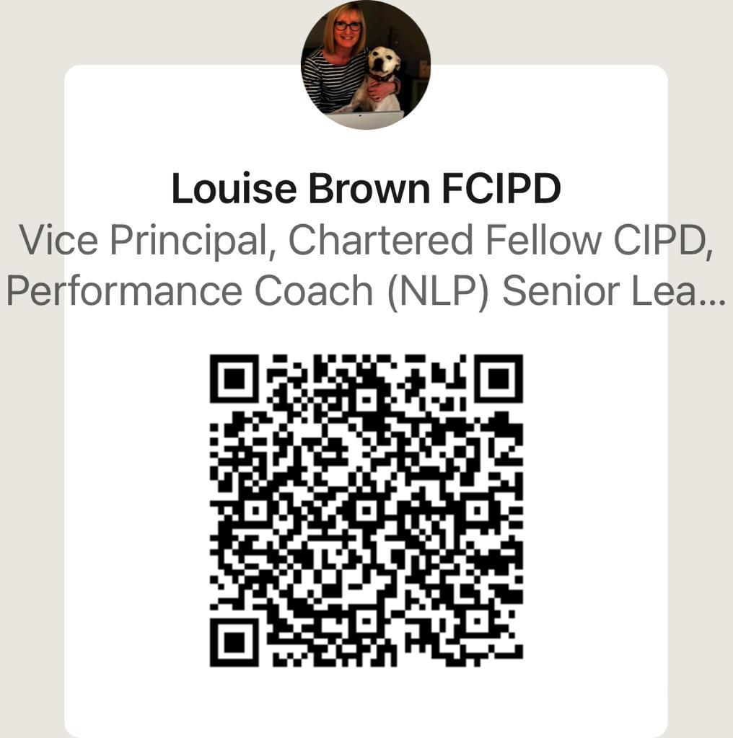

Slide 27
Q&A

Slide 28
Next Steps
Slides will be sent to you and uploaded to website
If you’d like to speak at a future event, please email contact@gmgoodemploymentcharter.co.uk
Become a Supporter – Registration Form is here
See you in 2024!
#GoodPracticePowerHour

Slide 29
Thank You for Attending
GMgoodemploymentcharter.co.uk
@GoodEmpCharter
#GoodPracticePowerHour
Supported by

