Slide 1
The Good Practice Power Hour:
Health and Wellbeing
Recruitment
Thursday 28 September 2023
Speakers
Alessandra La Via Live More Offline
Kate Thomas Osborne Thomas
Alexia Rhodes Good Employment Charter
Supported by

Slide 2
Welcome
Introduction and housekeeping
Health & Wellbeing – Alessandra La Via, Founder, Live More Offline
Recruitment – Kate Wilson, Business Development Manager Osborne Thomas
Q & A
Next Steps
End
#GoodPracticePowerHour

Slide 3
Housekeeping
This webinar is recorded
Chat function to connect with attendees
Q&A function specifically for questions
Please keep microphones muted unless asking a question
Reaction button
#GoodPracticePowerHour

Slide 4
Health & Wellbeing
Alessandra La Via, Founder
Live More Offline

Slide 5
Digital Wellbeing
Alessandra La Via Live More Offline

Slide 6
Our digital habits
have an impact…
Aargh… [composing email]
I’ll quickly check my email just in case there’s anything
urgent…
If I send this email now, Sarah will see it when she next logs on…

Slide 7
80
The Problem
Digital habits impact
business KPI’s
Not being able to unplug’ is the greatest employee challenge in remote work
Wellbeing
On average
employees lose
minutes a week to ineffective video call practices
Productivity
But leaders find it hard to see, measure and influence the impact…
60%
of women feel
excluded from important meetings when working remotely
When employees feel that technology helps them make meaningful connections with coworkers, loneliness falls by
10%
Retention
Inclusion

Slide 8
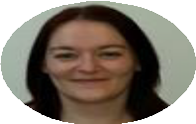
Case study: Using digital culture to boost productivity and achieve a successful shorter working week pilot
Situation:
A UK charity was looking to pilot a shorter working week to improve employee experience.
However, it was unsure about how this would impact productivity and wellbeing or if their people would find the reduction of working hours challenging or stressful.
They wanted to reduce the risk of these
challenges and best ensure the success of the pilot.
Approach:
Result:
The pilot was a success and the group transitioned to the shorter working week permanently. When people were polled after the first sessions and work around ways of working, 100% of people said productivity had improved and 98% said wellbeing had improved. After the pilot ended, employees specifically mentioned the previous workshops and we are in the process of delivering the final 3-part series.
Alongside internal initiatives creating ‘ways of working’, they commissioned Live More Offline to run four workshops focused on digital productivity, deep focus and smarter use of asynchronous work before the pilot started. The aim was to ease the transition by gaining back time lost to email, chat and meeting practices alongside the pilot.
During the pilot they ran the Digital Culture Diagnostic to understand their people’s challenges further and be able to make changes during the pilot itself
With meeting culture identified as an area for improvement, they went on to run another 3-part series of workshops focusing on meeting culture
We found the digital culture diagnostic report incredibly useful as part of our 4.5 day working week trial. Being able to see the breakdown of gender, age, and caring responsibilities is vital for us to check we are being as inclusive an organisation as we can be.
Jess Badley
Director of People and Resources, British Society for Rheumatology
III.

Slide 9
Digital Productivity Workshops
1
“Instant improvements to take away and make to increase productivity”
“The digital productivity sessions are really useful because they gave our whole team practical tips and ideas that they would implement straight away”
Aims:
Dispel Myth of multitasking
Adopt Three modes of Work Framework
“These workshops will definitely help us to move to a 4.5 day week.”
Further Asynchronous Work Adoption
Improve productivity and gain time
I found these
sessions so
useful in understanding how to work better, especially digitally. The benefit of these sessions is not just new information and strategy but it has also been gaining insight into the thoughts and perspectives of other colleagues through discussion - which completely shifts your thinking patterns!

Slide 10
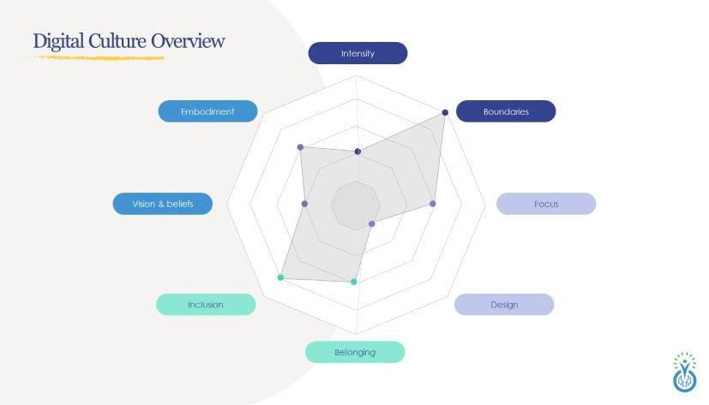
Digital Culture Diagnostic
2
Digital Culture DiagnosticTM insights into YOUR people
Using the DCD, the group was able to see how their employees experience digital work, and the impact on key performance indicators (KPIs), including issues like video call fatigue, the struggle to disconnect, loneliness, and digital distraction.
They used the insights and recommendations to make tailored changes to improve their employees’ digital ways of working.
Demographic cross-breaks showed how these experiences varies for different groups – helping the group care for inclusion in digital work

Slide 11
Meeting Culture Workshops
3
I will now be thinking about alternative ways to provide updates or training that reduce meeting time
The purpose of the workshops was to:
Reduce over-reliance on meetings
“I I am going to provide dial in and walking compatible details to my future meetings, and will use the hide me view on my camera”
Introduce when to call a meeting
Reduce meeting fatigue
Video on or off?
It will make me to think more if the meeting is necessary and how i can make them more productive (e.g set clear aim, get everyone to prepare, make them shorter if possible)”

Slide 12
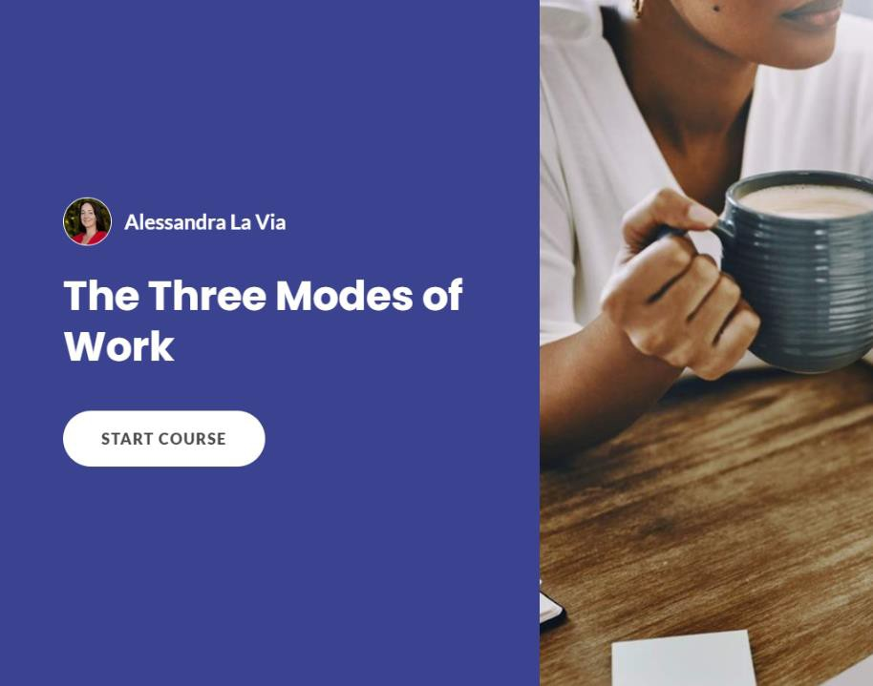
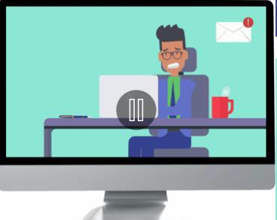
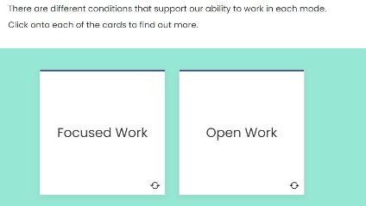
Digital learning
4?
Digital learning provides
immediate support
License specific modules which:
Gain time by reducing over-use of meetings
Embed deep focus
Reduce digital burnout
Make meetings more effective
Increase belonging in digital work
Manager modules… and more
To find out more, and access a trial module, email team@livemoreoffline.com

Slide 13
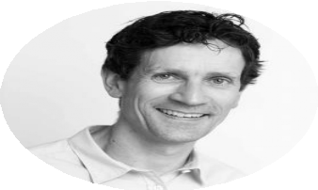
To find out more about improving digital culture in your workplace
Together let’s create YOUR unique solution…
Alex La Via championing the cause of digital wellbeing – and the importance of renegotiating our relationship with technology – is leading the way for what will surely be the biggest topic for individuals and organisations on the next five years.
I would be delighted to 30- minute exploratory call contact:
Alessandra La Via (CEO)
team@livemoreoffline.com
Bruce Daisley,
Author of Eat, sleep work repeat and
forthcoming book Fortitude
www.livemoreoffline.com

Slide 14
Recruitment
Kate Thomas , Business Development Manager
Osborne Thomas

Slide 15
www.osbornethomas.org
The importance of tight and ‘high touch’ recruitment processes.
Zelakah Murphy – 07938 601778
Kate Wilson – 07768 885564
www.osbornethomas.org
Notes:
Bit of a talk at session as we only have 15 mins!

Slide 16
Osborne Thomas
Osborne Thomas is a modern, innovative provider of both recruitment and HR consultancy solutions.
Preferred suppliers to multiple organisations & ESPO, LGRP & CCS frameworks
Generalists we recruit across all disciplines within salary levels £50k-£150k
65% of our assignments are repeat customers
Key sponsors/strong relationships/connections; CIPD, PPMA, REC
REC Award nominees; Recruitment Team of the Year, & Best Company to Work For
Notes:
Bit about us.
Zelakah focused on the importance of the EVP and employer branding last time, this time we are focusing on recruitment.

Slide 17
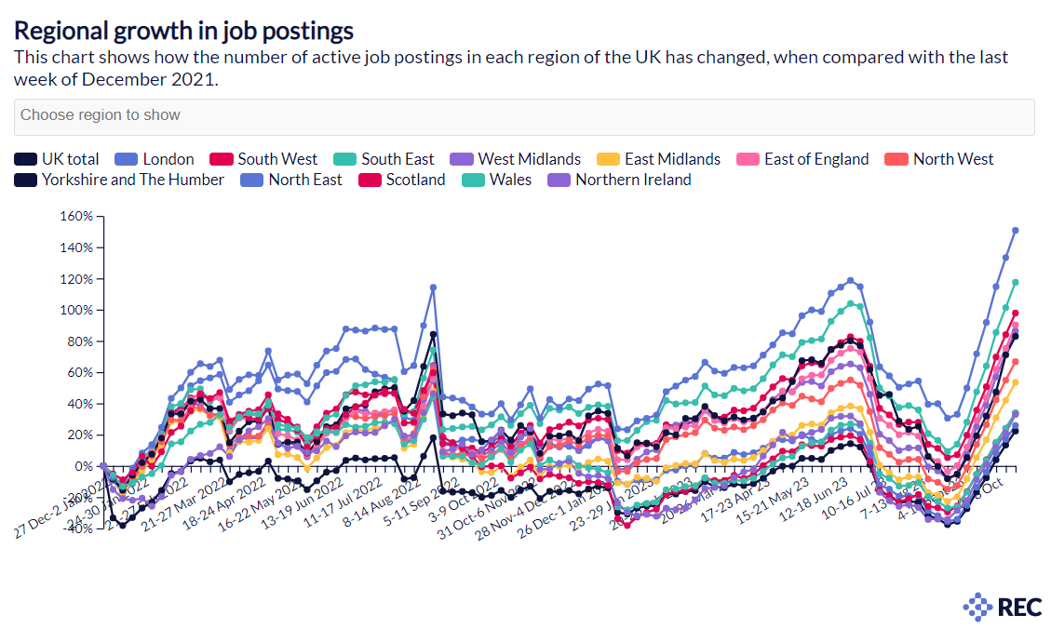
Market context
Notes:
ONS, the UK is still in the midst of a skills shortage, with vacancy numbers still historically high, despite signs of slowing month-on-month.
Half of the UK’s employers can’t find enough qualified candidates for the roles they have, with almost a third (29%) revealing that their direct competitors are beating them in the race for top talent.
Challenges across all disciplines now.

Slide 18
After 6 weeks I went elsewhere.
Following my interview, I never heard anything.
Market context
The IV panel were intimidating, and all white males.
I was another white male.
71% of candidates drop out of recruitment processes (ONS Oct 23)
The process was taking too long
It was too complicated/too many touchpoints
The organisation is non-inclusive
Yet – only 9% of employing organisations think their recruitment processes are complicated (PM 2023)
Every stage had to be F2F.
I had to keep chasing the offer letter.
Notes:
Recruitment processes cost money, and time. And if done poorly – reputational damage.

Slide 19
Fly fly away…
Notes:
Might this be you, your organisation? Your candidates disappear because your recruitment processes are poor, and you are in denial.

Slide 20
Time to review
Mystery shop.
Notes:
Put yourself in the position of the candidate…

Slide 21
Good practice?
One set of assessment only – if required.
ED& I training; language, imagery, workplace provision.
Communicate and provide feedback at every stage of the process.
18-day recruitment process.
Be prepared.
Two-stage interview process maximum.
Initial/informal interview or at least some communication within 48 hours.
Think about the make-up of the interview panel.
Notes:
Candidate retention will increase by 34%.

Slide 22
www.osbornethomas.org
Thank you.
Do reach out to us.
Zelakah Murphy – 07938 601778
Kate Wilson – 07768 885564
www.osbornethomas.org

Slide 23
Q&A

Slide 24
Next Steps
Slides will be sent to you and uploaded to website
We’d love to hear from you if you’d like to speak at a future event contact@gmgoodemploymentcharter.co.uk
Next Good Practice Power Hour is on Thursday 14 December.
Become a Supporter – Registration Form is here
#GoodPracticePowerHour

Slide 25
Thank You for Attending
GMgoodemploymentcharter.co.uk
@GoodEmpCharter
#GoodPracticePowerHour
Supported by

