Slide 1
Challenge 1
An employee at Company X approached their manager about feeling isolated in the office. They did not feel part of the ‘friendships groups’ and this made them feel anxious about coming in. Although attempts were made to mix groups, this was not successful. The relationship between the employee and line manager has now broken down which has increased their feelings of isolation.
Company X would like to ensure all colleagues feel part of a team and there are no cliquey groups, which could also cause issues for new starters.

Slide 2
Table Discussion
Please discuss this challenge as a group.
You may wish to consider:
What are the key issues?
How would you approach this in your organisation?
What advice would you give this employer?

Slide 3
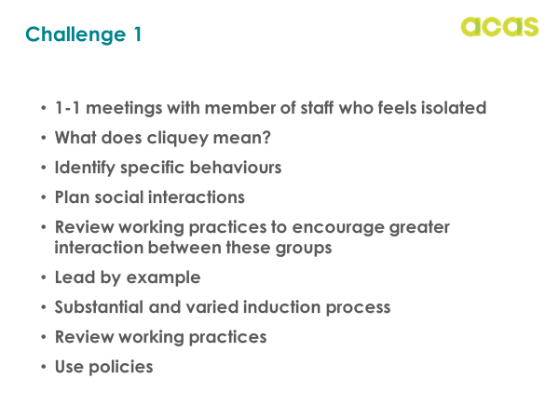
ACAS
Notes:
The manager should be holding 1-1 meetings with this member of staff as there are indicators that they may be struggling to build relationships with manager and team members.
What is the impact on her wellbeing, impact of anxious feelings, is this something that she has experienced previously?? Is she receiving medical help with this
May need to use the wellness action plan, induction plans,
Asking questions such as why she feels isolation – specific examples to help identify root cause of this issue
Consider the word cliquey – before you can rectify any issues it is important to identify the behaviours that are inappropriate. – eg is somebody being rude, leaving people out, being unhelpful?
There is also mention that others have mentioned this – so not a one off incident
There may a cultural issue that needs to be addressed – what can managers d to change the culture –
social interactions such as informal coffee chats once a month meet somebody different)
Involve a range of people in the induction process of new starters – people outside their team, different departments, different friendship groups, allocate a buddy/mentor
Induction planned to engage the individual as much as possible
Address any inappropriate behaviours in these cliques – informal conversations, respect at work policy
Managers lead by example
Is there any working practices that need to be reviewed to develop wider interactions – team meeting, review communications, office working, shift patterns
Refresher Training- respect at work, behaviours appropriate etc
Cliquey groups in workplaces may have become more apparent during pandemic when employees not interacting with wider teams in an organisation

Slide 4
Challenge 2
Company X have noticed many staff continually working extra hours whilst working from home. They are concerned this is creating an ‘always on culture’ and that this will lead to stress and burnout. They want to make sure all staff have a healthy balance between work and home and that the company is setting the right example.

Slide 5
Table Discussion
In your groups, please share your thoughts on the challenge and consider:
What are the key issues here?
What actions would you take to resolve these issues?
How would you secure buy in from staff to the new ways of working?
What steps could you take to stop the problem reoccurring?

Slide 6

ACAS
Setting Examples
Impact of ‘always on’
No work life balance
Hard to switch off
Limited recharge/refresh
Minimise creativity/innovation
Stress
Frustration, no engagement
Burnout
Conflict
Notes:
Lets look at impact of these working practices on individuals
Always on, apps on personal devices, laptops, working space in living space, working space interacts with our home life so differently now, always a reminder.
Always dipping in and out of work – why do people feel the need to do this – too much work ,demands of the role, job design
HSE – work place stress standards – 6 stressors – control, demand, relationships, support, role, change

Slide 7
Challenge 3
Company X has an employee who was signed off work with stress due to a marriage breakdown. They received full pay for 6 months and then Statutory Sick Pay.
Colleagues saw the employee on holiday on social media whilst off sick and felt their absence was disingenuous. The employee attended the company’s annual conference [whilst off sick], consuming lots of the free alcohol and food.
The employee has refused to attend or engage properly in conversations with Company X about returning to work and says she has been treated unfairly.

Slide 8
Table Discussion
Please discuss this challenge on your tables.
You may wish to consider:
What are the key issues?
How would you approach this in your organisation?
What advice would you give this employer?

Slide 9
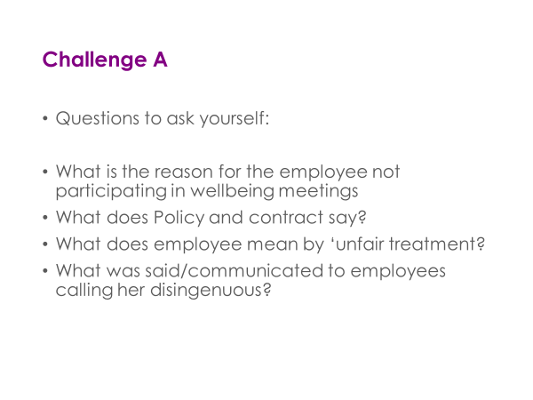
ACAS
Challenge 3
Notes:
Why does EE not wish to engage in wellbeing meetings:
relationship issues
How does she feel about the process?
Lack of trust
How has this situation been managed by line manager – have they been supportive, encouraging, explained the importance of these meetings, explained they are required, looked at alternatives to get the EE to engage (telephone calls, remote links, support)
Employee informed of what it says in contract/policy – their own responsibilities in these circumstances – has EE and ER acted fairly and reasonably
Medical support – is oH used or access to medical reports – to help employer make decisions on when EE likely to return to work
What might get the employee to engage – emotional support from friend etc, different person holding them, telephone calls, away from work premises
Being unable to work on fit note from doctor does not mean EE cannot do other activities – 2nd jobs (unless conflict or contractually not allowed) holiday, rest, recuperations. This may need to be explained to EE as well as trust/understanding, respect at work principles. Line manager should nip this in the bud

